Slide 1
Applied Data Science Capstone Project

Slide 2
Introduction:
This is the final assignment as part of Applied Data Science Capstone project.
The problem we are trying to solve here is find a suitable area to start a new restaurant and also suggest the type of cuisine.
The people who would be interested in this work includes restaurant owners in the San Francisco area and also the enthusiasts of food business who wants to look at the geographical distribution of the restaurants and the popular cuisines across different neighborhoods of Bay area.

Slide 3
Data:
In order to accomplish the requirements above, we need to get some data related to the different types
of cuisines in the Bay Area. For our purpose we are mainly focusing on three different types of cuisines:
Mexican cuisines
Italian cuisines
Indian cuisines
As part of the research we found that restaurant operated in a shopping Mall food courts could be more profitable for certain business models.
These restaurants are low maintenance as compared to stand alone restaurants since the seating space and furniture are already provided to them.
All the data about the venues we need is being consumed from Foursquare database by making some regular and premium calls.

Slide 4
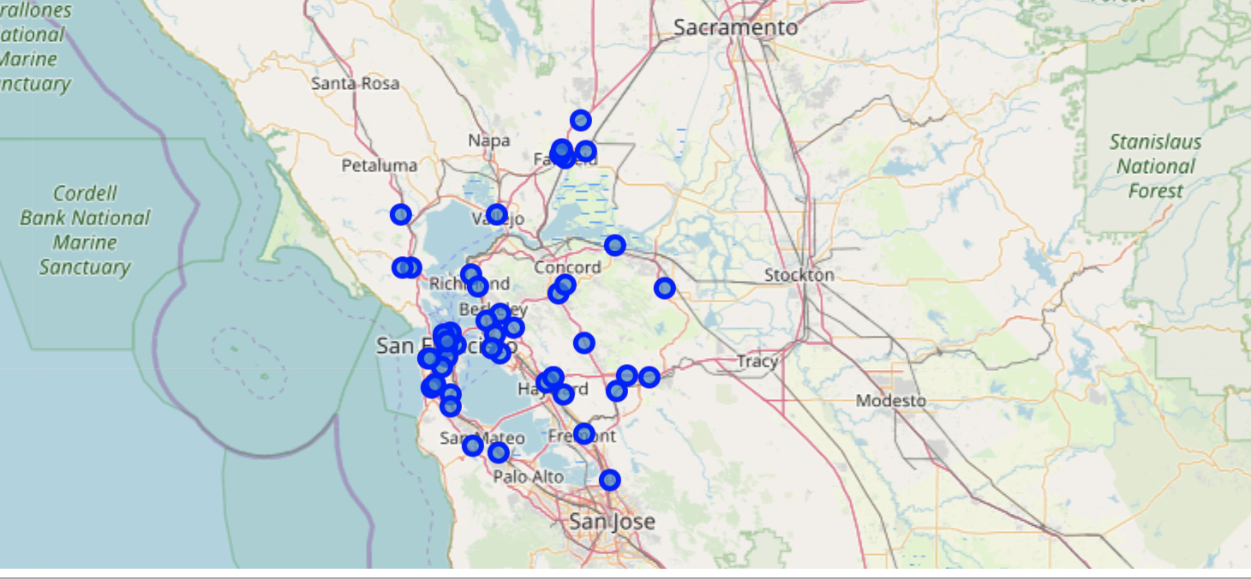
Italian restaurants in the bay area

Slide 5
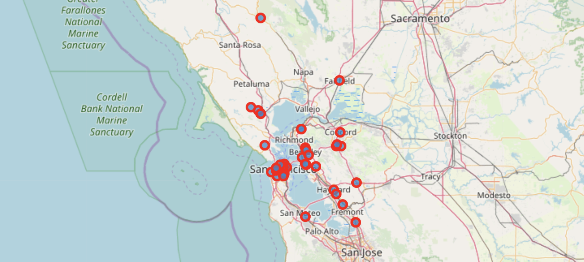
Indian restaurants in the bay area

Slide 6
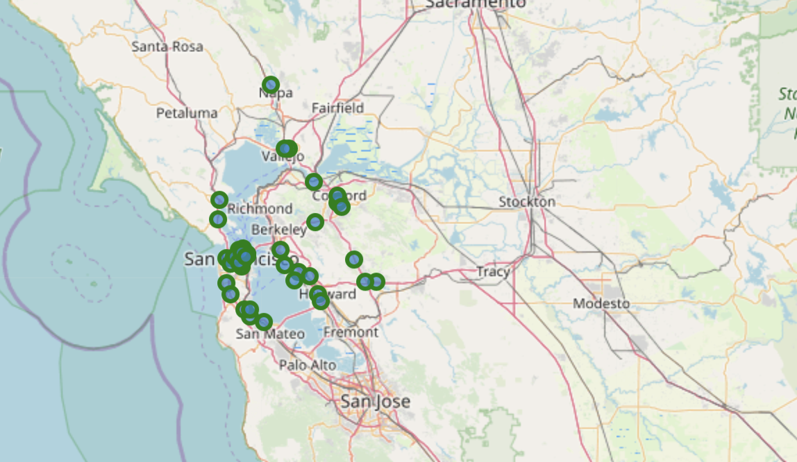
Mexican restaurants in the bay area

Slide 7
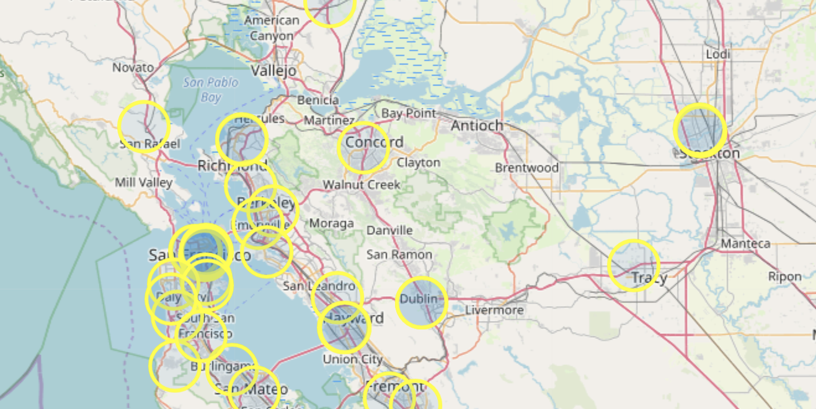
Malls in the Bay Area

Slide 8
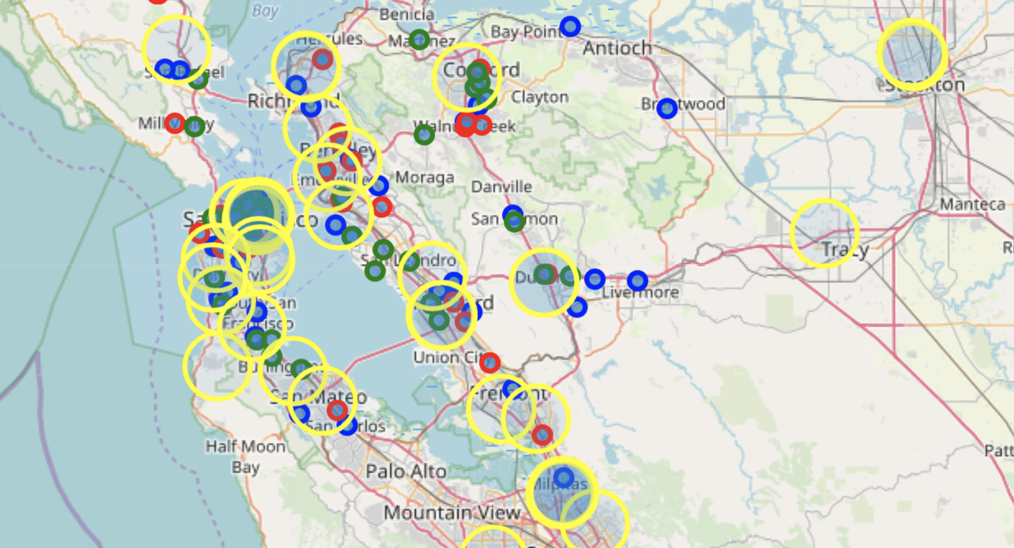
Combined Image

Slide 9
Conclusion
For Mexican cuisines,
Milpitas would be an ideal standalone location.
If a mall location is more appropriate for the business instead of standalone restaurant, Fremont mall would be an ideal location.
For Indian restaurants,
Livermore would be nice standalone location
Burlingame mall for food court location.
For Italian place,
San Leandro is good for standalone
Mountain View mall for food court location.

Slide 10
THANK YOU

